Slide 1
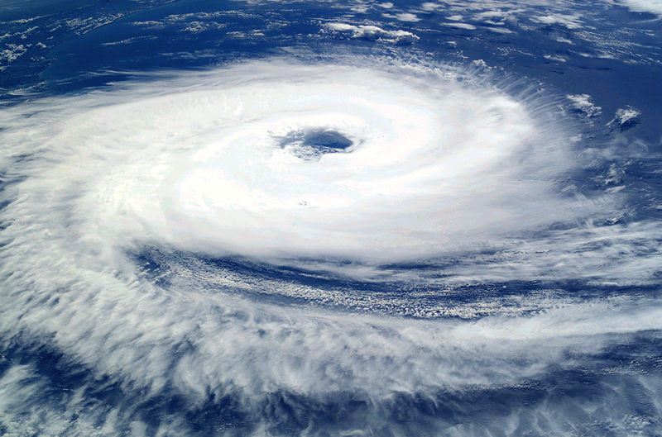
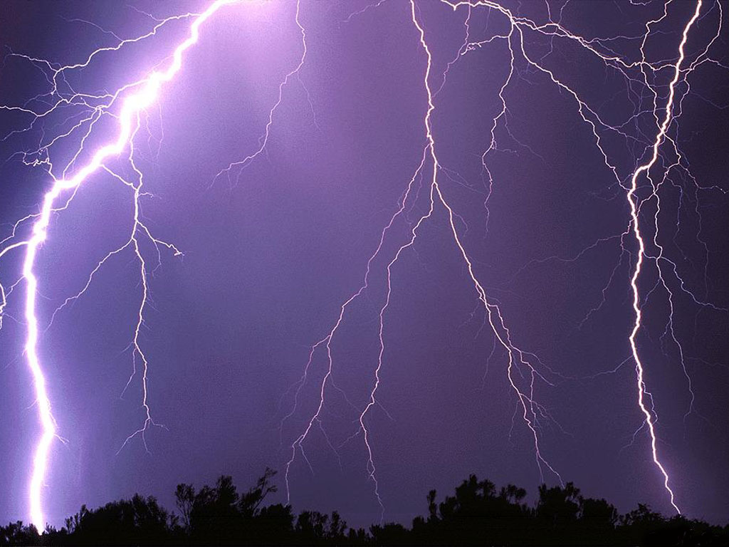
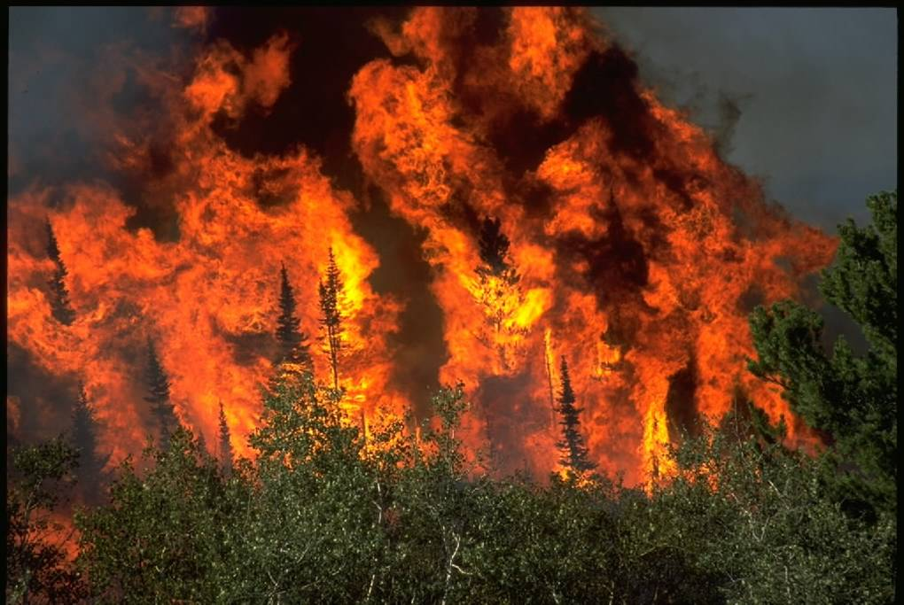
Anthropogenic Climate change
WORLD AT RISK

Slide 2
Scientists now believe…
'there is new and stronger evidence that most of the warming observed over the last 50 years is attributable to human activities' (IPCC 2001).
The IPCC is the International Panel on Climate Change which is an intergovernmental body tasked with co-ordinating research into climate change

Slide 3
2007 consensus
Warming of the climate system is unequivocal
Very high confidence that global average net effect of human activities since 1750 is one of warming
Human-caused warming over last 30 years has likely had a visible influence on many physical and biological systems
Continued GHG emissions at or above current rates would cause further warming and induce many changes in the global climate system during the 21st century that would very likely be larger than those observed during the 20th century.”

Slide 4
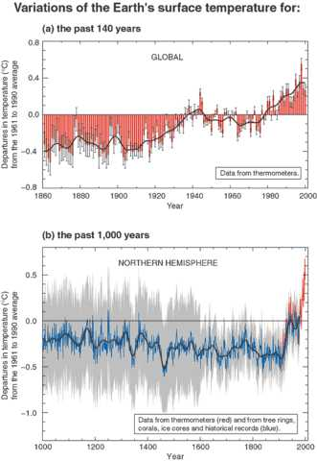
Climate change
These show that earth’s temperature has always fluctuated throughout time.
THE HOCKEY STICK CURVE

Slide 5
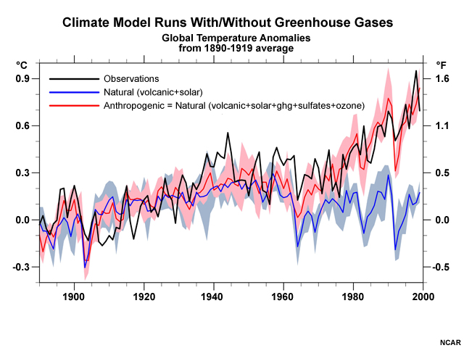
Climate change

Slide 6
Climate Change
http://www.youtube.com/watch?v=2Sgu2GOlLCw&feature=related

Slide 7
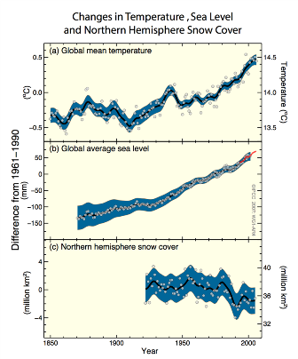
Climate change
What do these graphs show?
Why is this of significance?

Slide 8
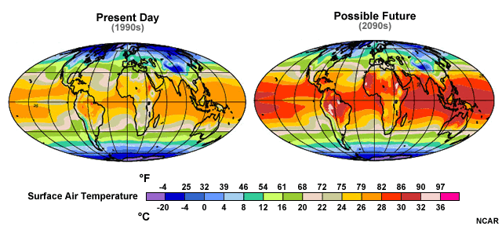
Why should we care?

Slide 9
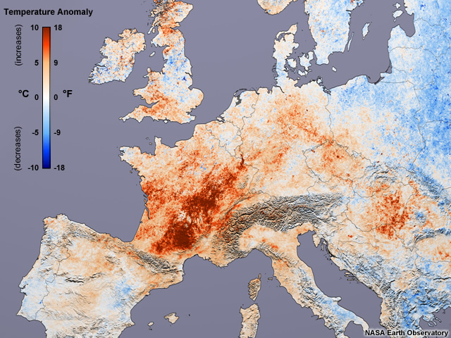
U.K.: Train rails buckle
Germany: Lowest river levels this century
France: >14,000 deaths
Switzerland: Melting glaciers, avalanches
Portugal: Forest fires
2003 European Heat Wave

Slide 10
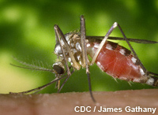
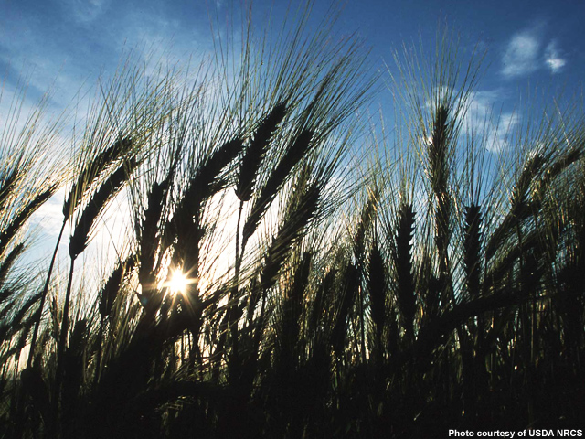
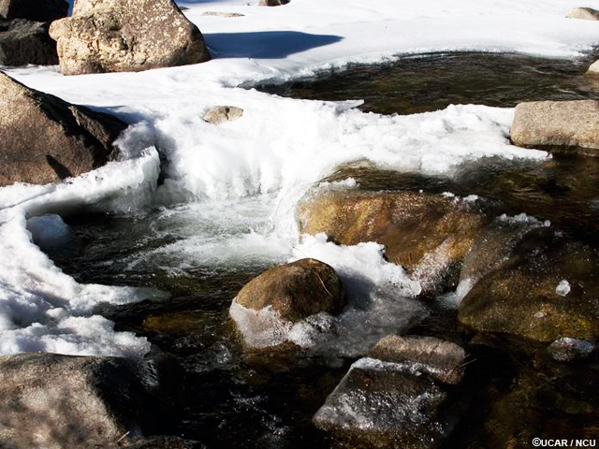

Slide 11
Memory Time
In your groups you will need one world map
You will then get two attempts to look at a map of climate change impacts
Whatever impacts you remember you must then add to your map
Team with the most complete map win

Slide 12
