Slide 1
What did we find out?
Who do we think has the right to the waters of the Nile?

Slide 2
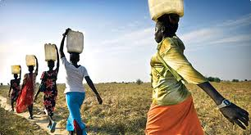
Water and poverty

Slide 3
African water crisis
The 1980s and 1990s saw the population of many African nations grow at an alarming rate
Many countries turned to their rivers as a catalyst for development
With many countries building dams to promote economic development (e.g. Aswan dam)
1980s many countries began to irrigate their land and encouraged people to grow cash crops (e.g. Green Beans)

Slide 4
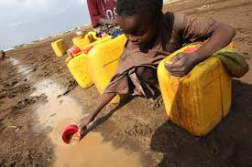
Africa's water future
Water in sub-Saharan Africa is already scarce
Climate change is set to increase the number of African countries which will be water scarce by 2025

Slide 5
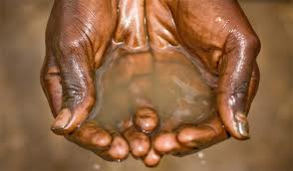
Africa's water future
As well as the unpredictability of climate change Africa also has a number of other issues to deal with, including
Increasing the number of people with access to safe water and sanitation
Raising people out of poverty
Managing and maintaining water resources

Slide 6
How is Africa coping?
Africa is an incredibly diverse nation and as such each nation is choosing to deal with these problems in their own way
But which is the best?

Slide 7
Your task
You are going to be given a particular approach to research, evaluate and then teach to others
Use the parrot book to help
Trade in virtual water
Major irrigation schemes
Small-scale projects

Slide 8
What do you think?
You have seen the various methods of dealing with the potential water crisis in Africa
Which do you think is the best approach?

