Slide 1
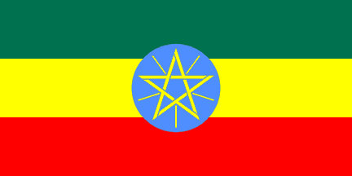
Who should have the right?
Both Egypt and Ethiopia are claiming that they are heavily reliant on the waters of the Nile
Egypt argue that Ethiopia are mismanaging the water supply and threatening their security
Research both sides f the argument and produce a report on their claims to the Nile

