Slide 1
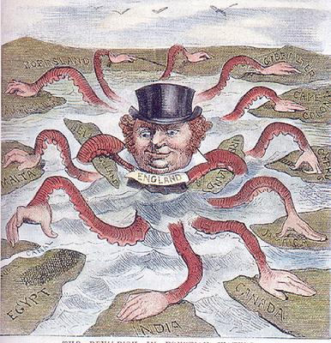

Slide 2
What is colonial rule?
Superpower Geographies

Slide 3
What do you already know?

Slide 4
Superpower Geographies 1. Superpower Geographies a) defining superpowers b) influencing power b) changing patterns of power c) theories explaining the growth of superpowers
Learning Objectives:
To know the difference between British imperialism and colonisation
To explain the concept of colonial rule using a specific example
Know basic reasons for the collapse of the British Empire
© Geography Department, London Academy

Slide 5
Imperialism – a relationship of political, economic or cultural control between geographical areas
Colonialism – the political rule of a nation by another
Colonization – the physical settling of people from a colonial power within their colony.
Which of these represents imperialism, colonialism or colonisation?
The political control of Burma by Britain. The introduction of Christianity in countries. English people moving to live and work in India.

Slide 6
TASK:
1) Give your map the title “The British Empire in 1919” 2) Using an atlas, shade the British colonies below onto your map. Use only one colour.
GUINEA (West Africa) CANADA INDIA MYANMAR (Burma) PAPUA NEW GUINEA AUSTRALIA NEW ZEALAND EGYPT SUDAN KENYA SOUTH AFRICA
GUYANA MALAYSIA YEMEN OMAN FALKLAND ISLANDS NIGERIA
Think! What do you notice about these countries? Why do you think these countries were colonised?

Slide 7
The British Empire was founded on exploration and sea power. The Royal Navy dominated the seas from around 1700 – 1930. The Navy provided a link between the home country and overseas colonies. The Navy was also a symbol of MILITARY POWER
TASK:
Add these major trade routes to your map.
Include a key showing i) British colonies ii) trade routes
UK > Guinea Guinea > South Africa South Africa > Kenya Kenya > India India > Malaysia UK > Falkland Islands
Question: Using the knowledge you have so far, give a simple answer to this question.
What was the British Empire?
Click Here for Explanation

Slide 8
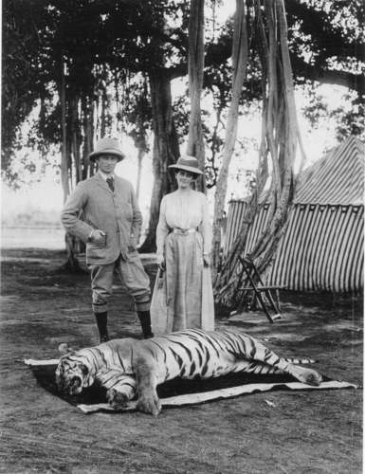
What does this image represent?
COLONISATION
Colonial India What were the benefits of the UK having a colony in India?

Slide 9
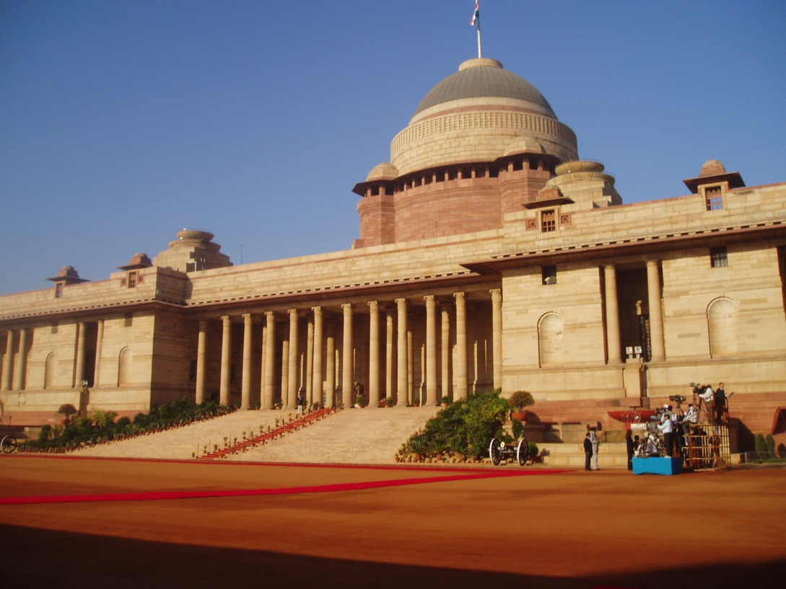
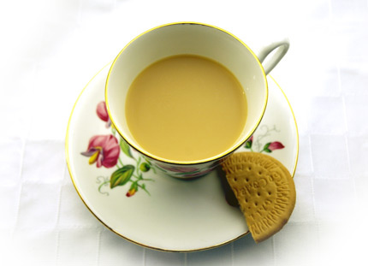
The current presidential palace in Delhi was built by the British as a symbol of political power. The navy surrounded the ports of India as a symbol of military power.
In order to maximise exploitation the British ‘modernised’ India building an extensive rail network. The British also introduced:
IMPERIALISM
CULTURAL IMPERIALISM
What power was being exerted by introducing these British traditions?

Slide 10
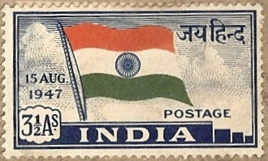
After the second world war the UK was bankrupt and could not support countries in its empire. Anti – colonial movements began and many countries pushed for independence. Most countries became independent by 1970.
India became independent from Britain on 15th August 1947.

Slide 11
Question
With reference to the British Empire, explain the concept of colonial rule.

