Slide 1
Research
What is water availability like in Australia?
National variations
Physical factors
Human factors
How do they manage their water security?
National Plan for Water Security
How does this differ from the UK?

Slide 2
What did we find out?
How do Australians manage their water?
How does this differ to the UK?

Slide 3
How do the wealthy cope?
WATER CONFLICTS
To understand how wealthy countries can still suffer water problems
To identify the key players involved in tackling the problems
To evaluate the solutions

Slide 4
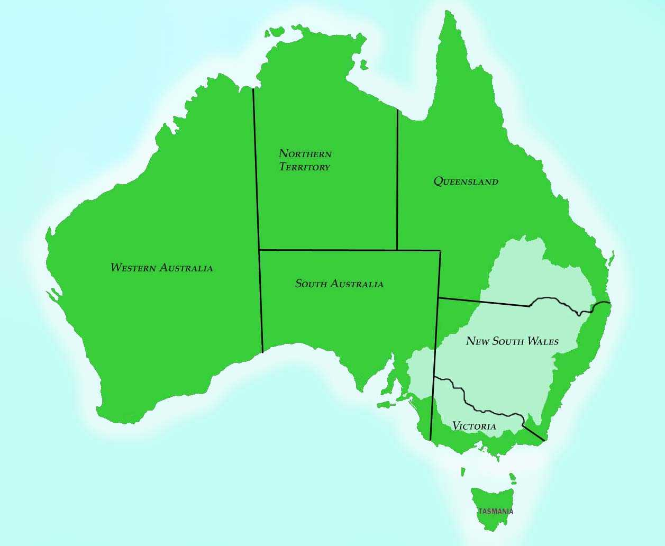
Where are we looking at?
http://www.youtube.com/watch?v=w1Bmti7It-g&feature=related

Slide 5
Why look at Australia?
1972 UK government considered the idea of developing a national water grid, which would have allowed them to connect areas with surplus to those with shortage
Government have reconsidered this again in 2006 but there are problems they need to overcome
Where as the Australian government declared a National Plan for Water Security in 2007, with the MDB being the main focus

Slide 6
Why did Australia opt for a national approach?
Australia is an arid country, with rainfall being seasonal and unreliable and unevenly distributed
Levels of precipitation are declining
Australians are the greatest per capita consumers of water in the world and population growth is increasing the pressure placed on supplies

Slide 7
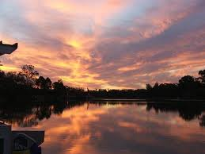
Why is Australia opt for a national approach?
Prior to the Plan each state managed its own resources, like in the UK, but the government felt that the old methods of management had reached their sell by date

Slide 8
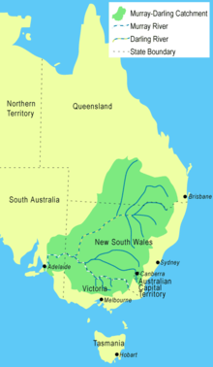
Murray-Darling Basin
14% of Australia’s land mass
Size of France and Spain combined
Provides 75% of Australia’s water
85% of the country’s irrigated water (40% national agricultural produce)
Home to 2 million people
Under threat as 5x increase in population has resulted in 5x increase in water extraction in the last century

Slide 9
What’s the problem?
The MDB only receives 6% of the Australia’s rainfall
But is known as the ‘food bowl’ of Australia due to the cattle and sheep ranches found there which feed millions
This is only possible due intensive irrigation schemes
This requires the relocation of large volumes of water
30 dams, 3500 weirs and networks of pipelines
Reducing the outflow by 80%
NOW
Floodplains no longer flood
Red gum trees along river banks are dying through lack of water
50-80% of native wetland birds and fish species are now extinct

Slide 10
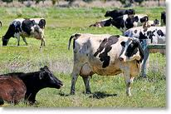
What environmental impacts are there?
Use page 85 create a spider diagram of all the environmental consequences of the irrigation schemes in the MDB

Slide 11
Conflicts and Management
There have been several attempts to manage the MDB
Murray-Darling Agreement
‘The Cap’
Murray-Darling Plan
Read pg 86-87 and evaluate each of these plans
Do you think the Australian government is doing enough to manage the MDB?

Slide 12
Final Thoughts
Management decisions made today reflect the priorities of the 21st century

Slide 13
Exam Practice
Referring to examples, assess the potential for water conflict in areas where demand exceeds supply. (15)

