Slide 1
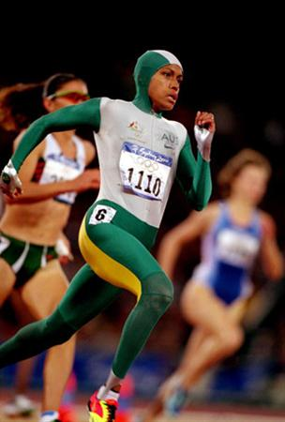
SYDNEY
2000

Slide 2
Sports Led Regeneration
Sydney’s bid to host the 2000 Olympics had to be unique, their bid was based on the first ‘Green’ Olympics.

Slide 3
A Green Olympics should:
Involve the adaptation of existing facilities
Be constructed on brownfield sites
Be financially solvent
Use building designs that are environmentally friendly
Undergo an environmental and social impact assessment
Minimise adverse impacts of Olympic sites on local people.
Protect native forests, bushland, ecosystems
Be accessible by public transport

Slide 4
Sustainability
What is sustainability?

Slide 5
What is sustainability?
Sustainability is:
‘the ability to provide for the needs of the worlds current generation without damaging the ability of future generations to provide for themselves’

Slide 6
Economic Sustainability: Will benefits match the costs? Will the facilities last for years?
Social Sustainability: Does the project benefit everyone? Including the poor and the old?
Environmental Sustainability: How will the project impact on the environment? How are the buildings designed to be environmentally friendly?

Slide 7
Task
In pairs you need to look at either the economic, social, environmental impacts of the Sydney Olympics
You must then produce a factsheet
Look at the short/medium/long term impacts of the games
Did Sydney achieve sustainability?

