Slide 1
Rebranding in London

Slide 2
London Docklands
On your post-it notes write down any positive and negative impacts of the rebranding efforts you can think of
Then stick your post-it notes in the relevant columns on the white board

Slide 3
London Docklands
POSITIVES NEGATIVES

Slide 4
Rebranding London
6th July 2005

Slide 5
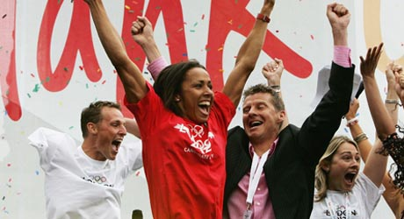
LONDON 2012

Slide 6
What does it mean to host the Olympic Games?
11,000 athletes
300 events
£9.4 billion
47,000 volunteers
7,000 sponsors
9 million spectators
20,000 journalists

Slide 7
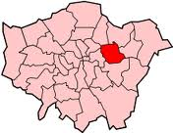
Rebranding of East London
Newham is undergoing a rebranding scheme at the moment
This rebranding is taking place on an international scale
How is Newham rebranding itself?
http://www.youtube.com/watch?v=uWwsxgXo7TE&feature=related

Slide 8
Why East London?
 | NEWHAM | LONDON | ENGLAND
Unemployed (16-74yrs) % | 6.72 | 4.36 | 3.35
Managers and senior officials | 11.09 | 17.58 | 15.26
Elementary occupations | 14.92 | 8.92 | 11.8
No Qualifications | 33.58 | 23.72 | 28.85
5+ GCSEs (A-C) | 16.28 | 17.06 | 19.36
Life Expectancy (females) | 80.5 | 83.1 | 82.3
Life Expectancy (males) | 76.2 | 78.6 | 78.3
Violence to another person | 7,467
Criminal damage | 3,663
Theft from a motor vehicle | 4,476

Slide 9
Why East London?
Using the census data about Newham I would like you to compare this to the data about London and England.
Do you think hosting the Olympic games will change this?

Slide 10
Why host the games?
Why would a country want to host an Olympics Games?
One half of the room need to come up with the positives of hosting the games
The other half must come up with the negatives of hosting the games
I want you to think about both TANGIBLE and INTANGIBLE costs and benefits

Slide 11
Why host the games?
POSITIVES NEGATIVES

Slide 12
A lasting legacy?
Evaluate how far do they agree that the Olympics will leave a legacy of environmental gain?
http://www.london2012.com/legacy-after-the-games

Slide 13
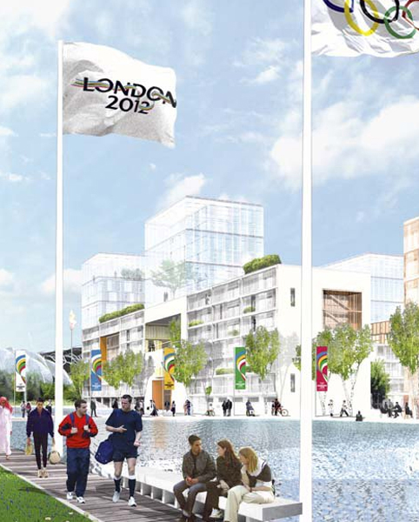
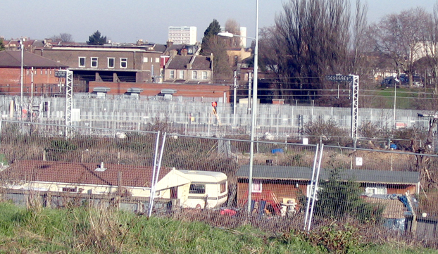
A lasting legacy?

Slide 14
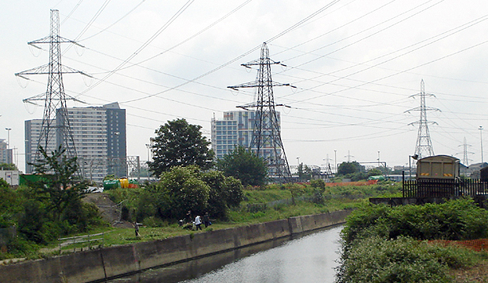
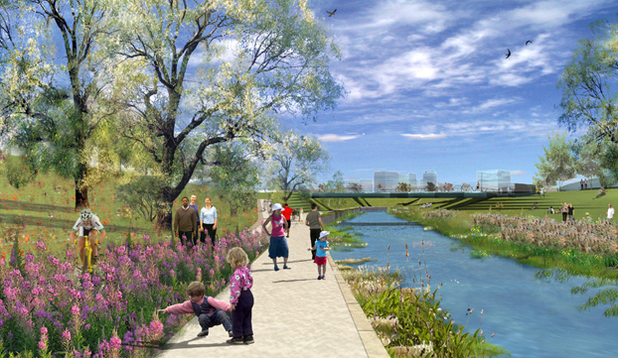
A lasting legacy?

Slide 15
Is this a good rebranding strategy?
Using the text books (angel fish) and the computers next lesson you are to research the London 2012 games.
Who are the key players and what conflict could there be?
Impact on the local economy
Impact on the local environment
Impact on the local people
Improvements in transport
Impacts on a larger scale
The legacy of the games

