Slide 1
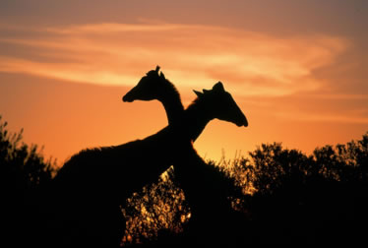
Impacts of Climate Change on…
Africa
By
Lauren Pavey
Caitlin Berry - Allwood

Slide 2
Environmental Impacts
Arid or semi-arid areas in most of Africa are becoming drier, resulting in desertification.
Equatorial Africa and some parts of southern Africa are going to be flooded by the rise in sea level.
Rise in sea levels will flood the fresh water lakes etc. where people get their drinking water from.
On average, the continent is 0.5°C warmer than it was 100 years ago, but in some areas temperatures have risen much higher, such as a part of Kenya, it has become 3.5°C hotter in the past 20 years.
Coral reefs in the Indian Ocean around Africa are being lost due to the rise of temperature in the oceans; this is affecting the marine wildlife.
Birds migrate between Africa and other continents; if the climate changes they would have to change their migration patterns.
Groups of large mammals, such as rhinos and elephants, migrate for dry and wet season grazing, which is very sensitive to climate change.
There are several unique native environments, to which the slightest change in climate could seriously threaten the plants life cycle.

Slide 3
Economic Impacts
Reports show that $10bn (£5.2bn) and $40bn (£20.8bn) is needed annually to help the countries adapt for climate change.
Industrialised countries have given only $43m - a tenth of the amount they have pledged - while rich country fossil fuel subsidies total $73bn a year.
Roughly 70% of Africa’s population make a livelihood by farming, so the environmental impacts would put the majority of the continent’s population into unemployment and an even bigger degree of starvation.
People who are already living in poverty will need more aid from abroad to help them to adapt to the change in climate.
The countries won’t be able to grow as many crops to export, meaning less of an income for the country.

Slide 4
Social Impacts
More water stress will probably cause more disagreements between countries over how to manage the water.
Less food would cause more rioting.
There are nomadic societies which historically lived in semi-arid areas of Africa and migrated with the annual and seasonal rainfall variations. These societies are at risk due to the wetter areas and are already densely populated, the water in the drier areas is starting to drying out even more, soon there will be no water.
This has resulted in widespread loss of human life and livestock, and substantial changes to the social system.
The average number of food emergencies in Africa per year almost tripled since the mid 1980’s.
A lot of people would be unemployed which causes lots of problems within society.
The relationships between neighbouring countries will be more strained over the short supplies of food and water.

Slide 5
Conclusion
Although Africa’s greenhouse emissions are very low, it will suffer a lot because of the affect the MEDC’s high emissions are having on the world’s climate.

