Slide 1
The great Alaskan wilderness
BIODIVERSITY UNDER THREAT

Slide 2
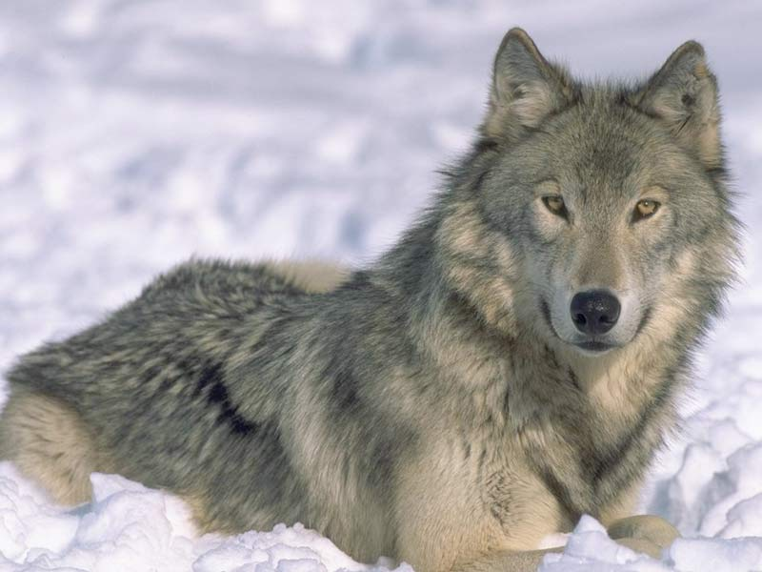
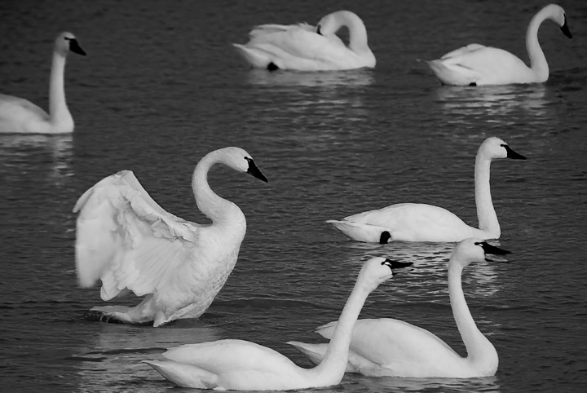
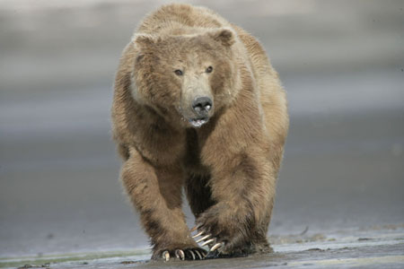
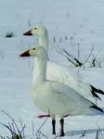
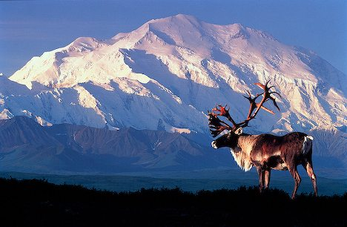
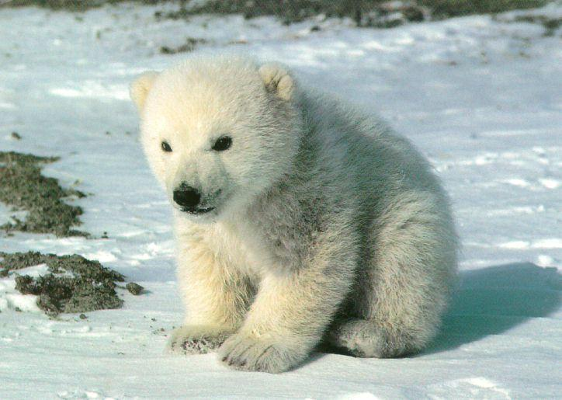
What is the link? Why is this place important?

Slide 3
ANWR
National wildlife refuge in NE Alaska
Largest National Wildlife Refuge in the country
1960 became a federal protected area and was expanded in the 1980s
Congressional authorization is required before oil drilling can take place
Currently no roads within or leading into the refuge, but there are a few Indian settlements

Slide 4
Alaskan National Wildlife Reserve
Using pages 94-95 of the parrot book I would like you to write a case study of the ANWR
Where is it?
What is the climate?
Comment on the ecosystem
Comment on the biodiversity

Slide 5
The problem
The question of whether to drill for oil in theArctic National Wildlife Refuge(ANWR) has been an ongoing political controversy in the United States since 1977
Democrats are against the drilling where as the republicans are for the drilling

Slide 6
The tundra
“I hope people understand, in a 20,000-square-mile area, this is 2,000 acres. It is a plot of land the size of LAX that we would want to drill to explore. ,"

Slide 7
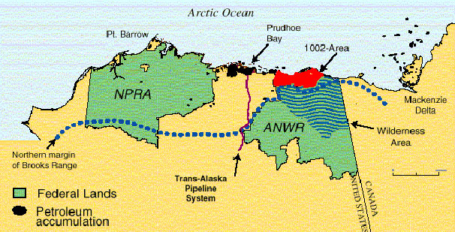
http://www.youtube.com/watch?v=sklBatcXAhs&feature=related for

Slide 8
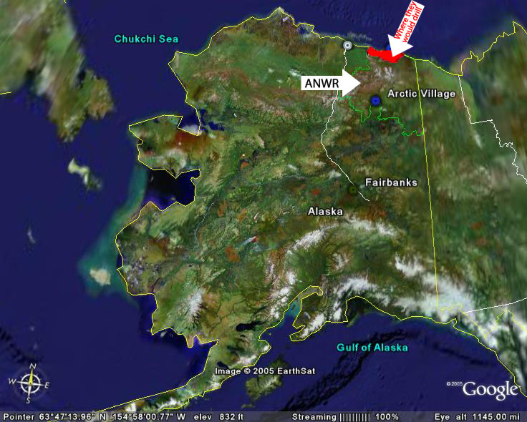
http://www.youtube.com/watch?v=KEeyDj_hRys&feature=fvsr
http://www.youtube.com/watch?v=ewbHBJkhz6g&feature=related against

Slide 9
Potential conflicts
I am going to assign you all a role, you must look up what your opinions on the ANWR development would be
You will then have to talk to other people and complete your conflict matrix
You can use pages 96-97 to help

Slide 10
Complete a conflict matrix of the various views
 | Politicians | Arctic Power | Alaskan Residents | Inupiats | Gwich’in | Environmental Groups
Politicians
Arctic Power
Alaskan Residents
Inupiats
Gwich’in
Environmental Group

Slide 11
What impacts will this have?
Complete the table about the impacts that the drilling for oil will have

Slide 12
Decision time
Should we protect this area of is the need for oil too great?

