Slide 1
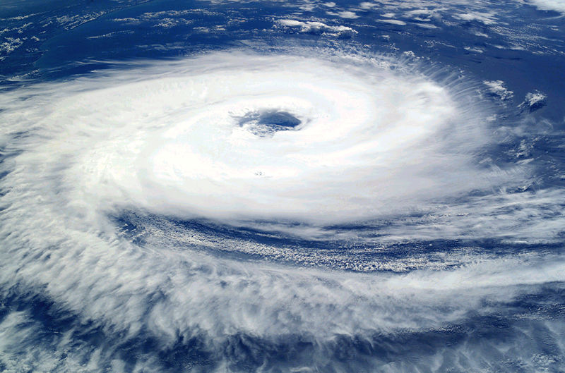
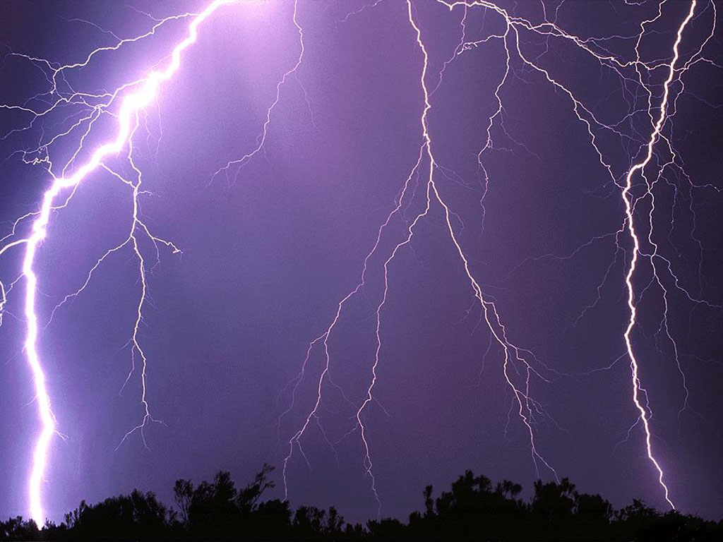
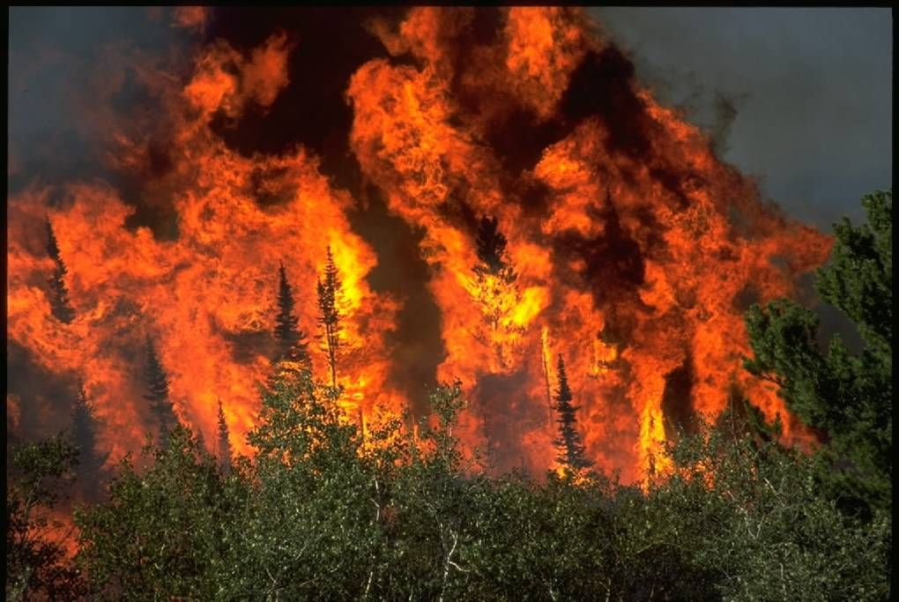
Dealing with climate change – carbon offsetting
WORLD AT RISK
Lesson Aims:
To understand the concept of carbon offsetting
To evaluate the ETS
Use example to demonstrate carbon offsetting

Slide 2
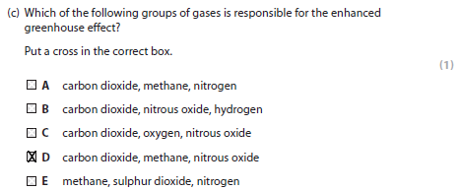
feedback
Q3c was a question about gases and which are responsible for the enhanced greenhouse effect.
This has often been an area of weakness.
It is something that might be covered at GCSE, but needs a very quick review at AS level.

Slide 3
Gases ?
Gas | Source | Global warming?
Oxygen | Photosynthesis | No
Carbon Dioxide | Respiration, vulcanism + burning fossil fuels | Major contributor
Sulphur Dioxide | Vulcanism + burning fossil fuels | No. Has a net cooling impact along with black carbon (soot) – global dimming.
Nitrogen Oxides | Vulcanism, nitrogen fixation, lightning + burning fossil fuels | Major contributor
Methane | Animals / decomposition + farming, leaks, waste | Major contributor, powerful greenhouse gas
Ozone | Natural (stratosphere) + pollutant (troposphere) | Cooling in the stratosphere, localised warming in the troposphere (cities)
Carbon monoxide | Incomplete combustion. | Limited because it is short lived.

Slide 4
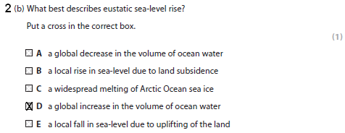
Terminology
Q2b This question is a ‘classic’ knowledge question
Complicated by the fact that it uses a bit of key terminology that is in the Spec
May be unfamiliar leading to many students not being able to unlock the meaning of the question:

Slide 5
Sea levels
Overall, sea level is not well understood with confusion over what is causing sea level rise now and how much it is rising by.
Rising by 1.8mm per year
2007 IPCC estimates 20-60cm by 2100; scientific consensus of 0.5-1m by 2100.
Largely driven by thermal expansion and mountain glacier retreat
Greenland / Antarctica currently contribute very little; partial melt of these ice sheets after 2100 would add 6-8m
Arctic sea ice and Antarctic ice shelf collapses do not contribute (ice is already in water)

Slide 6
Sea levels
Q2c was a question which directly asked for an explanation of how global warming might lead to rising sea levels.
With this type of 4 or 5 mark ‘explain’ question:
Bullets usually work against explanation – bulleted answers tend to be descriptive with separate, unlinked points
A sequential explanation of a process works well
Extended (detailed) points and examples will gain additional marks.

Slide 7
2 examples to compare:
Example 1 | Example 2
Global warming is when humans make the atmosphere much warmer by burning fossil fuels which releases carbon dioxide. As the atmosphere warms the Arctic ice melts. It is usually the Arctic ice which reflects the sun’s rays which keeps the earth warm at a normal temperature. As the ice melts as a result of global warming more ice melts and the warmer the earth gets. As the ice melts the sea level rises which floods low lying land. | Global warming is leading to a rise in global temperatures of a predicted 2C by 2050. As the world heats, the ice stores in the world melt. The biggest stores are the ice sheets in and , although these are not melting yet. Valley glaciers in and Arctic permafrost are melting and this adds water volume to the oceans which rise in response. More important now is thermal expansion of the oceans which is causing rising sea levels.

Slide 8



Is the IPCC right?
Students should be aware of some of the controversy surrounding global warming
Recognise that some people do not accept it is happening
or do not believe anything should be done about it.
E.g. Big business is often accused of ‘greenwashing’ because drastic cuts in emissions do not fit their business model.
On the other hand there are savings to be made by reducing energy consumption and waste production.

Slide 9
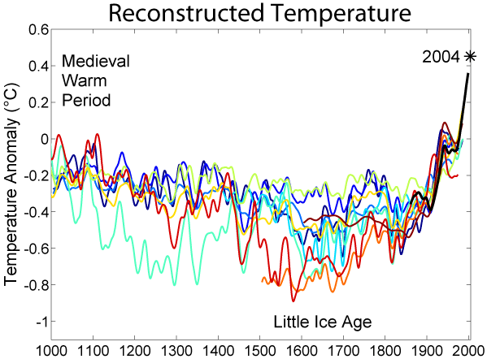
Hockey stick curve
Some people do not accept the Science e.g. the ‘Hockey Stick Graph’ controversy over temperature reconstructions produced by Michael Mann among others.
This graph cannot be ‘accurate’ in the modern sense before about 1900
It uses proxy data to reconstruct climate in the past
This does not mean it is wrong however.

Slide 10
A mountain of trouble?
Perhaps the most damaging controversies have been climategate in 2009 centred around UEA
scientists accused of supressing data that conflicted with the global warming consensus
no evidence of serious wrong-doing found
IPCC Himalayan glaciers error - the IPCC AR4 report in 2007 quoted a WWF report which used the year 2035 rather then the correct date of 2050.
“Glaciers in the Himalaya are receding faster than in any other part of the world (see Table 10.9) and, if the present rate continues, the likelihood of them disappearing by the year 2035 and perhaps sooner is very high if the Earth keeps warming at the current rate. Its total area will likely shrink from the present 500,000 to 100,000 km2 by the year 2035”

Slide 11

The IPCC has been criticised on other grounds
By the time its reports are published, the data is out of date because the process of writing the reports is now so complex (2500 scientists)
Political interference ‘softens’ some of the conclusions – most notably in 2007 that sea levels will rise 19-59cm by 2100, whereas many scientists think a figure of 100cm is more likely.
The huge nature of the reports (2007 report was in 4 volumes) making the message difficult to digest.

Slide 12
Get students to think about the different ‘players’ involved, what their views are and why their views are different:
Scientists e.g. the IPCC, the Royal Society | Skeptics – who are they, what are their views, what are their alternative explanations | Governments – why are some more ‘active’ than others?
Public – their views vary from country to country; in 2008 91% of Japanese believed global warming was a result of human activities, 48% in the and 64% in (Gallup Poll) | Business / TNCs – consider, briefly, the actions on two TNCs. Are they genuinely concerned, is it just good business sense (or a mix of reasons) | Local Government – always useful to know what is happening locally as LAs are the ones who implement policy (Agenda 21)

Slide 13
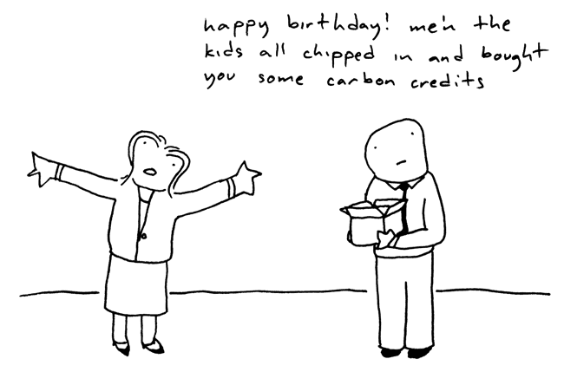
Carbon offsetting
What is carbon offsetting?
Carbon offsetting is the name given to a credit system, called carbon credits, which aims to reduce GHG emissions.
It allows companies to pollute but at a cost

Slide 14
What do you think?
Do you think the idea of carbon credits is likely to be effective?
Can you think of any advantages or disadvantages of this idea?

Slide 15
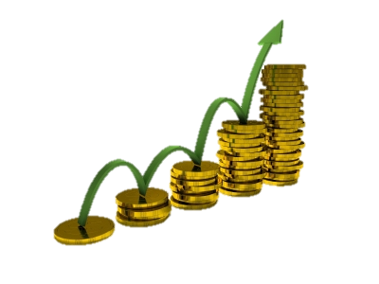
The European emissions trading scheme (ETS)
The EU ETS was the first large emissions trading scheme in the world after being launch in 2005, being a major pillar of EU climate policy.
The EU ETS currently covers more than 14 000 industrial outfits which are collectively responsible for close to half of the EU's emissions of CO₂ and 40% of its total greenhouse gas emissions.
Under the EU ETS, large emitters of carbon dioxide within the EU must monitor their CO₂ emissions, and annually report them.
Companies are allocated a number of credits, they must then try to control their emissions so that they do not exceed their credits.
If they have performed well at reducing carbon emissions then they have the opportunity to sell credits and make a profit.
This allows the system to be more self contained and be part of the stock exchange without much government intervention.

Slide 16
ETS AIMS
The ETS aims to:
  Cut emissions by placing a limit on the total amount emitted
  Get polluters to pay for damage they cause by introducing credits for the greenhouse gases that they emit. If their credit is more than they need, companies or countries can sell it; if it is less, they can buy credits from other to allow them to pollute over their limit
  Create incentives for companies to invest in cleaner technology
Over time the EU plan to reduce the number of credits available

Slide 17
Is it effective?
The ETS has so far failed in its aims:
  Manufacturing companies have been moving out of the EU
    What knock on effects will this have?
  Polluters are not absorbing the price of the credits, instead they are passing this on to the customer
    To achieve support credits were given out for free to start with, but the cost was still passed on to the customer, so electricity companies made a £800 million profit in the first year
  The low cost of carbon credits is not leading to investment in green technology
    There has been a recent shift from gas-fired power stations to coal-fired power stations which is the ‘dirtiest’ kind

Slide 18
Is it effective?
Businesses move out of the EU
Businesses continue emit the same levels of CO₂
It is cheaper for companies to continue to be ‘dirty’
Demand for carbon credits is reduced
Companies look to buy cheap credits rather than invest in green technology
Emissions remain the same they just change in their distribution

Slide 19

Over to you
In order to determine whether carbon offsetting is effective we need to see it in action.
Using pages 53 and 54 in the fish book I would like you to make notes on the 4 examples shown
  Consider the players that are involved in each
  Are they effective?

Slide 20
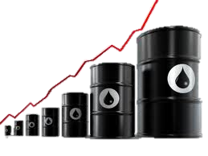
Over to you
Who should pay taxes on pollution – producers or consumers?

