Slide 1
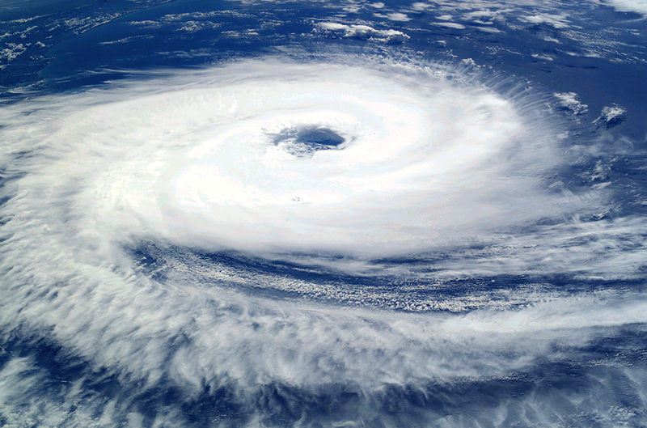
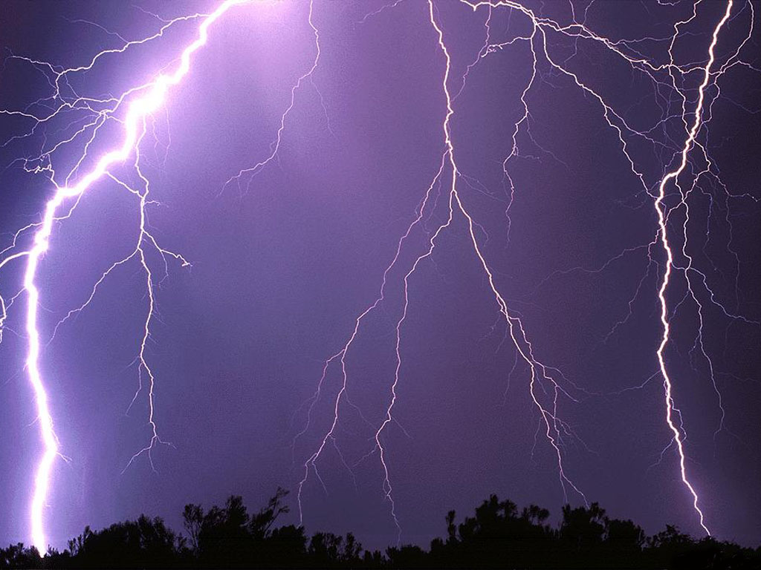
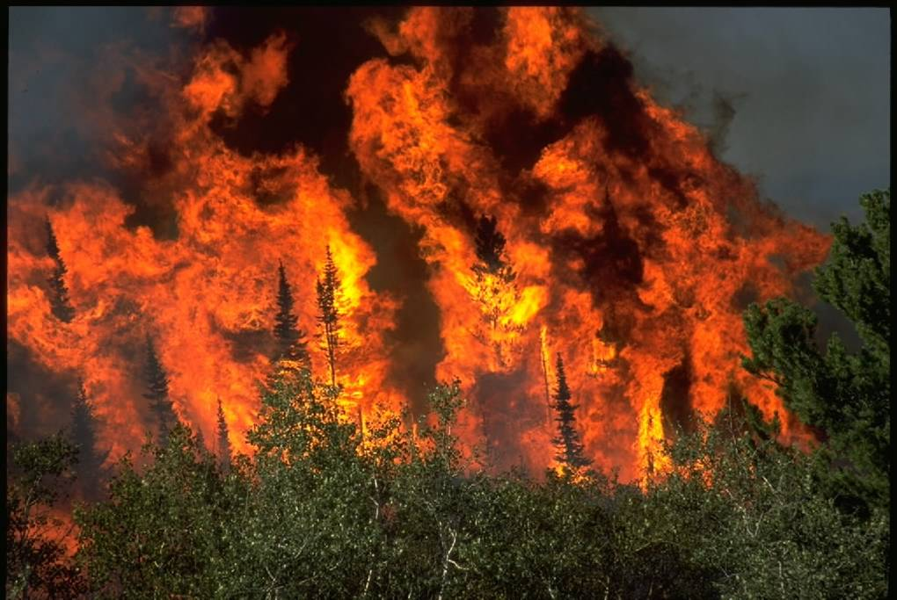
Dealing with Climate Change
WORLD AT RISK

Slide 2
How many do you know?
I would like you to come up with a list of schemes or ways that people have tried to tackle climate change?
Do you think these were effective?

Slide 3
The stern review
It is now accepted by almost everyone that we need to do something about climate change, but to many the cost of change is too much.
In 2006 Sir Nicholas Stern (a leading economist) published a review suggesting the costs of doing nothing were greater than the costs of adapting.
This was the first time that an important economist joined in a debate led by environmentalists.
Stern argued that if we could stabilise emissions by 2025 then GW could be reduced…this would cost 1% of

Slide 4
The stern review
Environmental Impacts
Increased flood risk
Declining crop yields
Rising sea levels leaving 200 million homeless
40% species becoming extinct
Economic Impacts
Extreme weather could reduce GDP by 1%
2-3°C rise could reduce economic outputs by 3%
5°C rise would mean a 10% lost of global output
Options for Change
Reduce consumer demand for heavy polluting goods and services
Make global energy supply more efficient
Prevent further deforestation
Promote cleaner energy technology
UK Government Response
Set targets to reduce CO2 emissions by 30% by 2020 and 60% by 2050
Pass laws to set carbon reduction targets
Invest in green technology
Create a $20 billion World Bank fund to help LEDCs adjust

Slide 5
Making a difference
Discuss what you think this statement means
Think global, act local

Slide 6
Do we really try?
In 2006 British Airways asked customers to offset the carbon emissions that their flight would cost (ranging on average btw £5- £15) less than 1% of passengers paid
Similarly Greenpeace offered train tickets to domestic BA passengers, saying flights do 10 times more damage to environment than the train. Few people took up this option

Slide 7
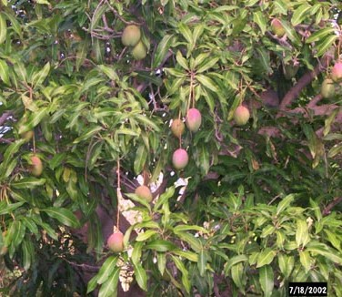
What links these?

Slide 8
Coldplay do their bit
Coldplay joined up with Future Forests to make their 2nd and 3rd albums carbon neutral by carbon offsetting
‘A Rush of Blood To The Head’ = 10,000 mango trees in Karnataka, India
‘X&Y’ = forest in Chiapas, Mexico

Slide 9
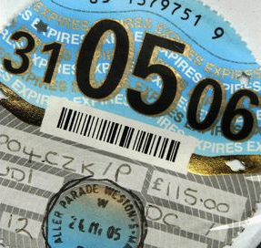
UK Strategy - tax
In the UK the government is encouraging the purchases of vehicles with low gas emissions by having tax brackets on car tax e.g.
Corsa 1ltr = £35
Ford Focus 1.6 ltr = £145
BMW 4.8 ltr = £400

Slide 10
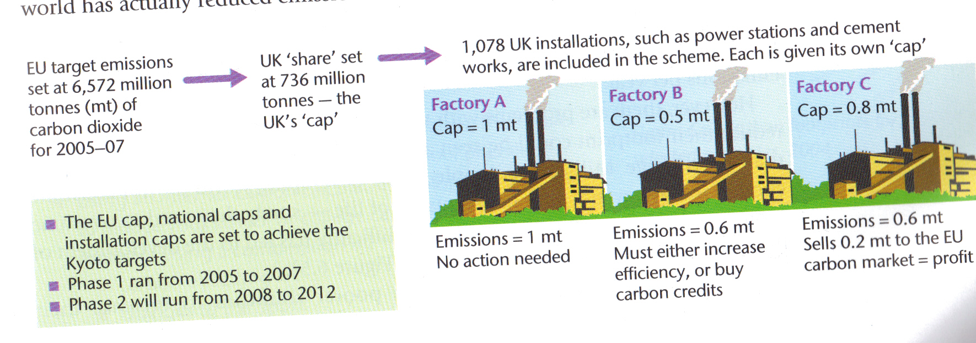
UK strategy - ETS
In the UK we are part of the EU Emission Trading Scheme set up in 2005 as a way of meeting the Kyoto targets for Europe
Sets a cap on pollutants companies produce
Companies can sell these credits if don’t use
ETS SCHEME

Slide 11
Uk strategy – agenda 21
Local councils are encouraged to implement sustainable strategies to reduce emissions.
Recycling Bins
Double Glazed windows
Energy bulbs

Slide 12
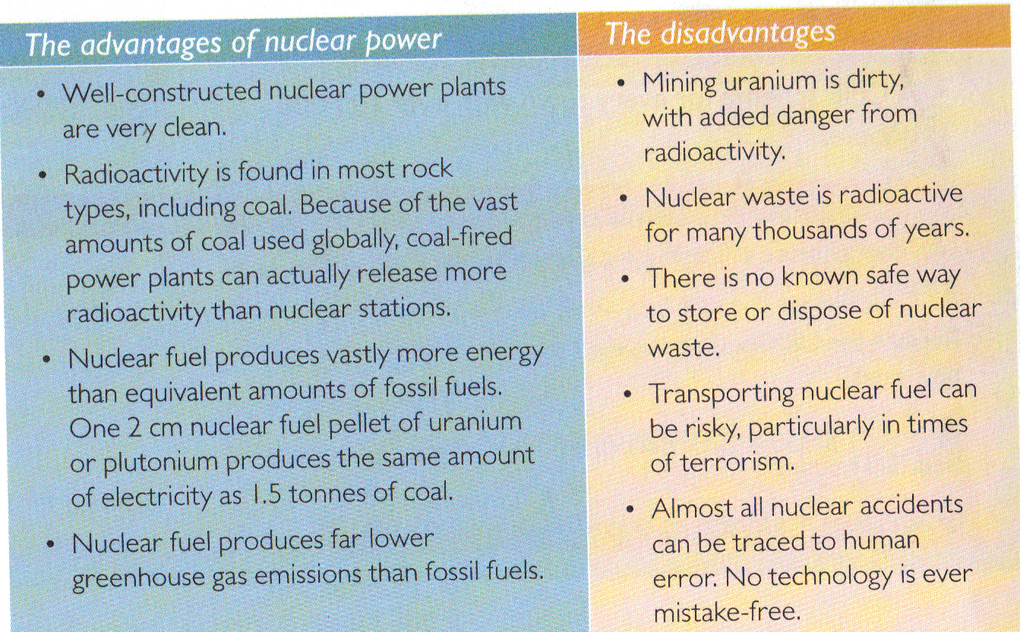
Uk strategy – nuclear power
Big debate over the use of Nuclear power in the future

Slide 13
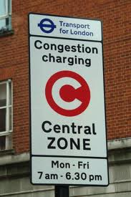
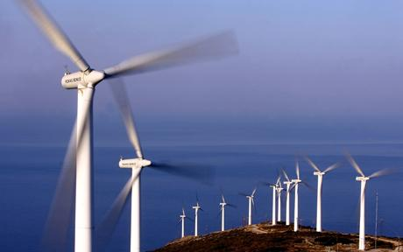
Are we doing enough?
Looking at some of the strategies the UK is implementing do we think we are setting an example or doing enough to get by?

